Slide 1
JavaScript and PHP AJAX, JSON & Objects
Sending JSON between
JavaScript and PHP via AJAX
CSCI221

Slide 2
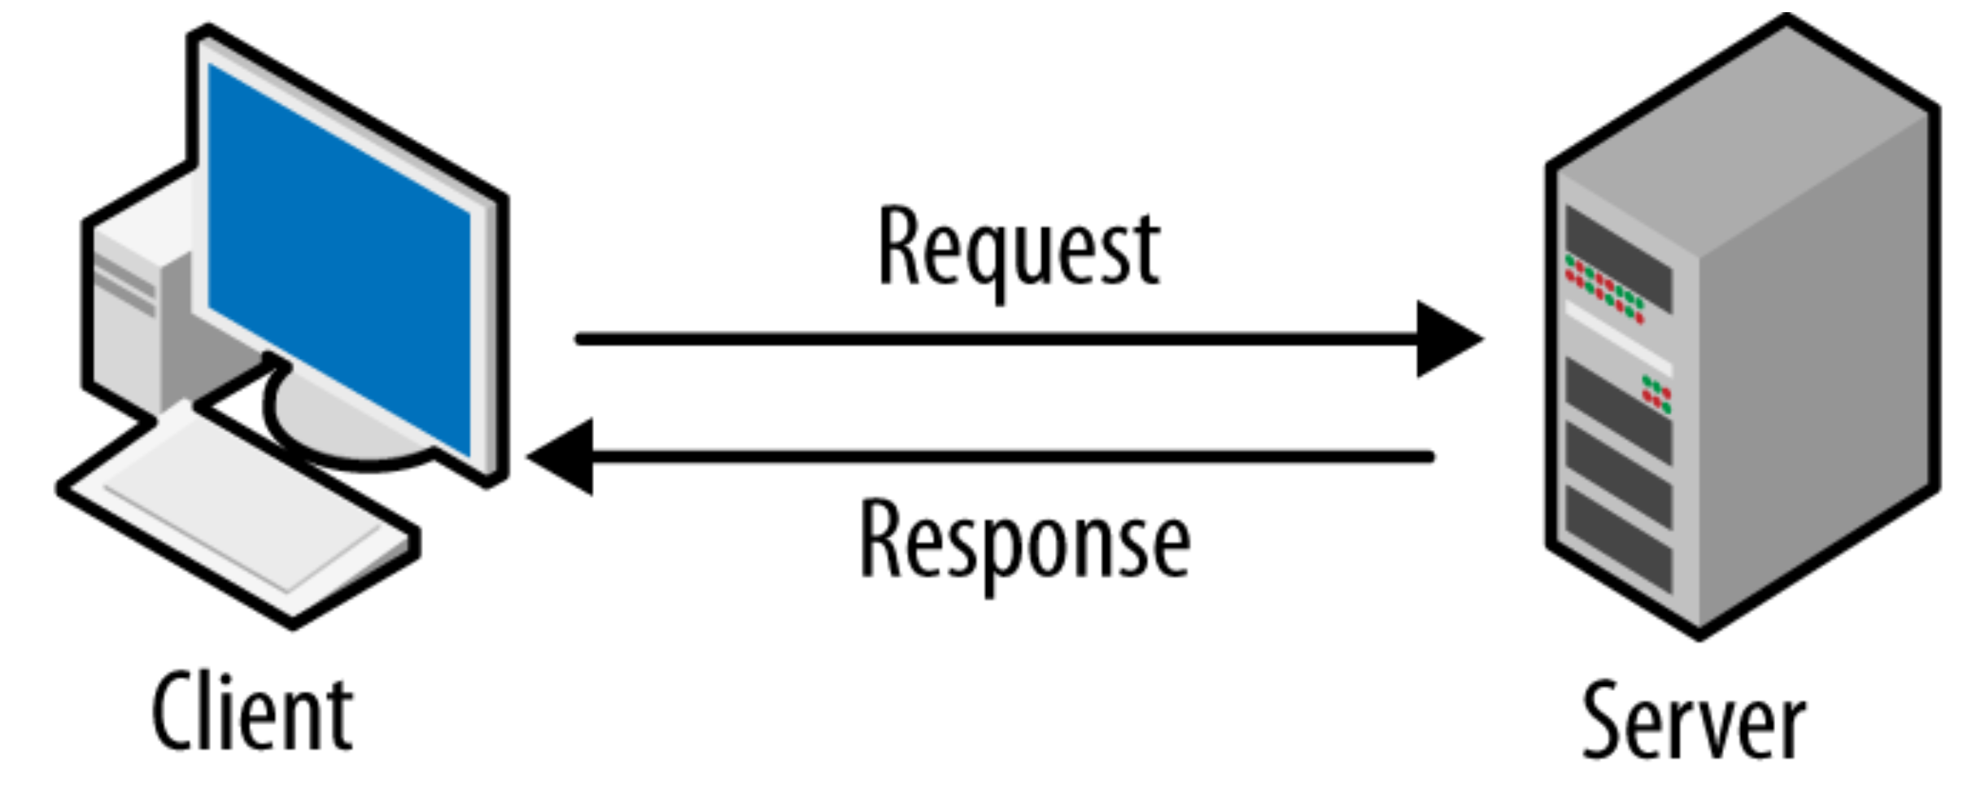
JavaScript: PHP:
GET
JSON.parse() json_encode()
HTML - e11.1-ajax-simple-object.html
PHP - e11.1-simple-object.php
1
2
Request Sent: GET request to PHP page for information. The GET request may also contain parameters (name/value pair).
Request Received: $_GET retrieves any name / value parameters and stores them in variables.
4
3
Info sent between systems is plain text in JSON format
Response Received: Convert responseText (JSON) to JavaScript object:
const person = JSON.parse(this.responseText);
Update DOM to display information in JavaScript person Object:
<div id="personName"></div>
<div id="personOccupation"></div>
...
Response Sent: $person object converted to JSON and response sent via echo.
echo json_encode($person);

Slide 3
JavaScript: PHP:
POST
JSON.stringify(), JSON.parse() json_decode, json_encode()
HTML - e12.1-ajax-simple-post-json.html
PHP - e12.1-ajax-simple-post-json.php
1
2
Request Sent: Use JSON.stringify() to convert JavaScript object to a JSON formatted string.
const paintInfo = {};
...
JSON.stringify(paintInfo);
Request Received: json_decode() converts to PHP object.
$paintInfo = json_decode($content, true);
Info sent between systems is plain text in JSON format
4
3
Response Received: Convert responseText (JSON) to JavaScript object:
const response = JSON.parse(this.responseText);
Update DOM to display information in JavaScript response Object.
Response Sent: $formInfo object converted to JSON via json_encode() and response sent via echo.
echo json_encode($formInfo);

